Slide 1
Capstone Project Update
First phase 5/11

Slide 2
Progress update
First phase: Finished!
Peak picking & assessment
Alignment & summary
Preliminary workflow integration
Second phase:
Clustering brainstorm & algorithm development
Establishment of the dilution prediction model
Multiple source tracking workflow development
Third phase:
Code testing, debugging and pack up for different versions towards user needs
Add more features

Slide 3
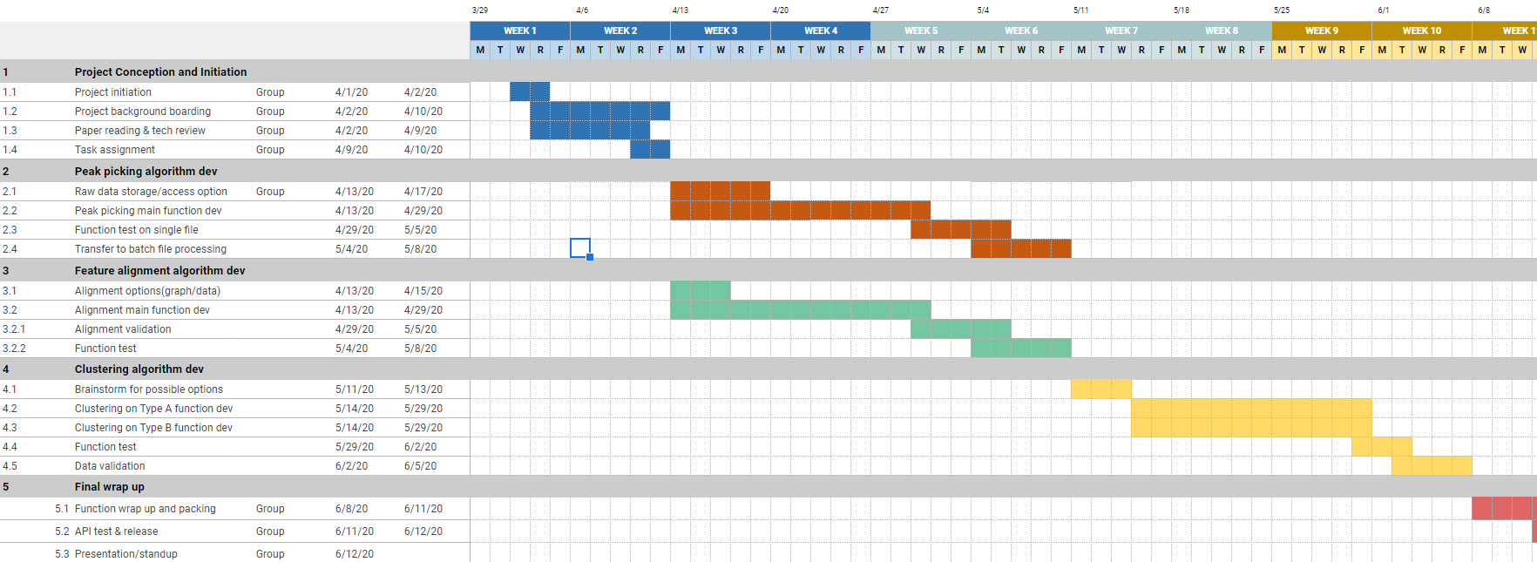
Progress update

Slide 4
Peak picking
Mzml file import
Mainly based on pymzml package, which provided a high efficiency access to the raw data even during iterations
Single file/batch files option available
Raw data cleaning
MS1/MS2 scan selection
Noise removal
Peak picking & peak table export
Mainly based on peakUtils package – similar to scipy.signal package
Utilized DNN model developed from TF to assess the peaks
In the export peak table, also added modeling score for user to define if to retain the features

Slide 5
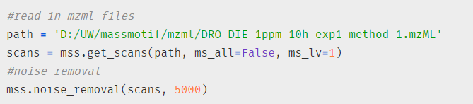
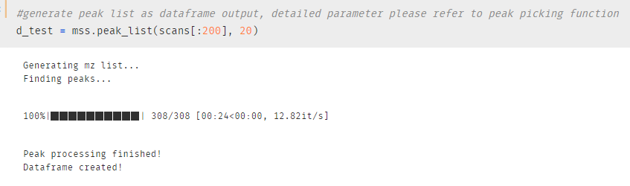
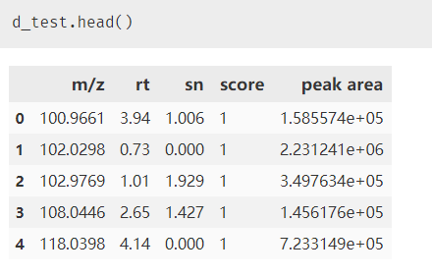
Sample output

Slide 6
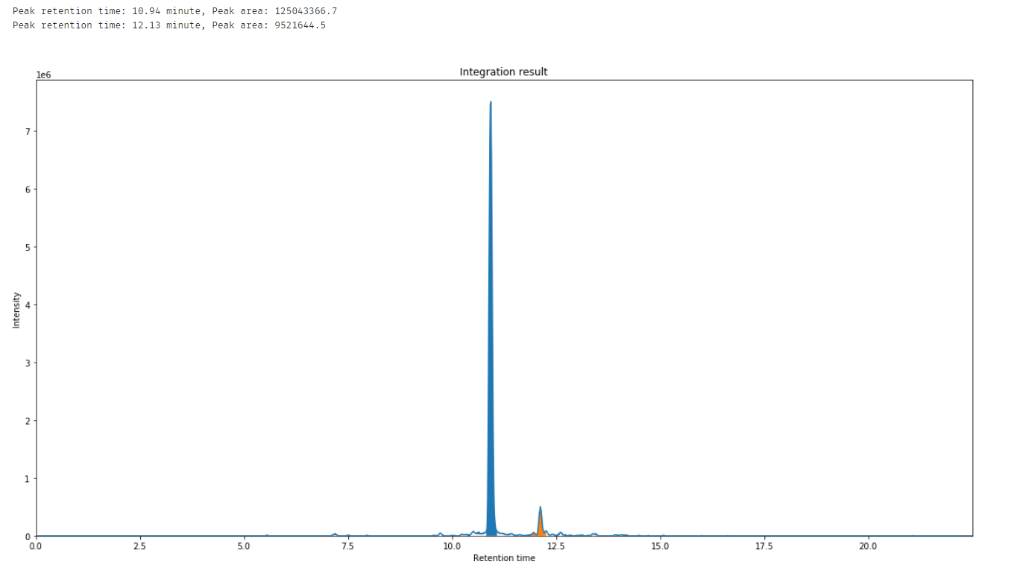

Slide 7
Alignment
Functionality
Reads in .csv files created from peak picking
1 spreadsheet representative of all samples
Method
Initial reference data frame created from first sample
Other rows cross referenced for overlap
Additional rows added to reference as needed
Calculates averages similarly to commercial output

Slide 8
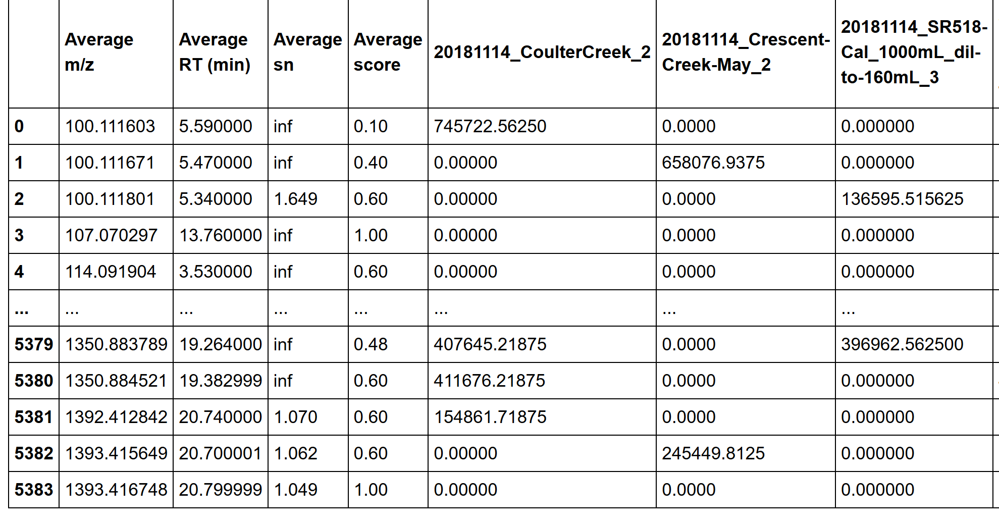
Alignment example output

Slide 9
Main features
General:
First package on python which provide full workflow from data import to alignment result
Light memory usage make it possible to be run on personal laptops (~4min per sample at 5000 noise threshold under current tests)
Hyak supercomputer utilization as remote data processing option
More customization space for user while still have the default ‘one click’ script
All workflow validated with MSdial sample outputs
Peak picking
Boost up the large file processing time by pymzml port
Provide assessment scores to improve the data quality by user needs
Alignment
Can do the alignment for 100+ files in ~10 min
Allows user to define mz, rt errors, and in what file type they want to save as

Slide 10
Main features
Provided flexible options to users:
Integrated script
Mzml in, spreadsheet out
Python package
Function combinations
More tools:
Visualization
Ms2 library search

Slide 11
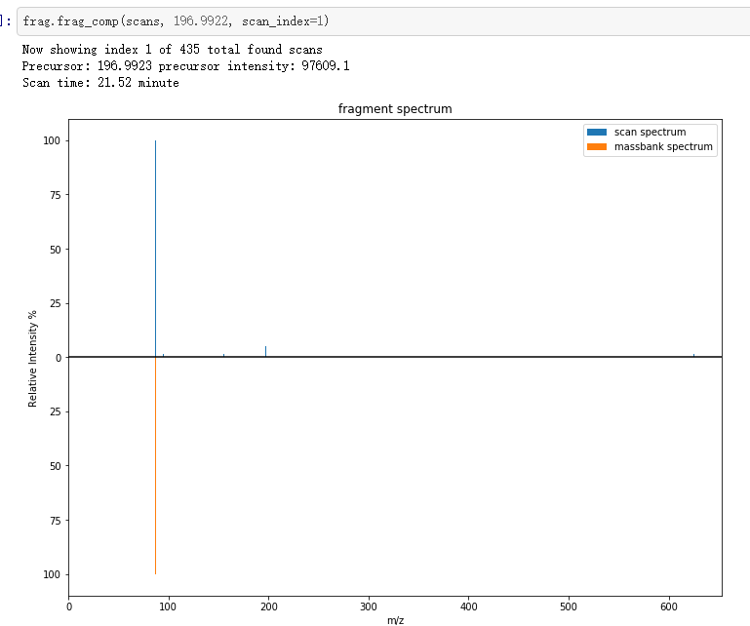
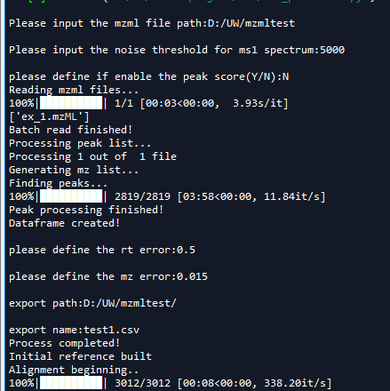
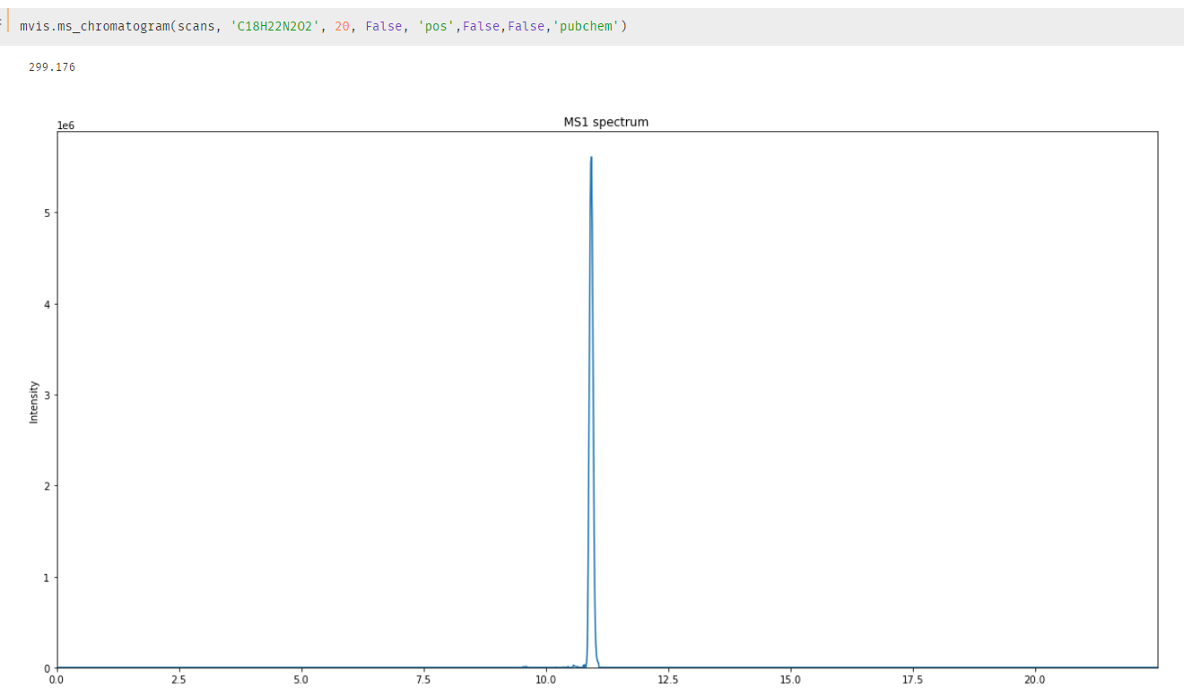
User cases

Slide 12
Next steps
Clustering algorithm development – second phase
Literature reviews – why to do and how to do
Algorithm development
Feature grouping algorithm
Prediction/source tracking model development
Validation and application – start from data at one place to create the ‘box’
Package development -- third phase & future works
Contribute the whole workflow as a user friendly and useful tools towards all MS users
Leave out spaces for further development and customization according to needs
Interactive GUI/webtools

Slide 13

Q&A

Slide 14
Brainstorm
Clustering:
How to find clustering – Q1
Based on data
Based on visual
How to use the clustering to achieve our goals – Q2
Dilution prediction
Source tracking

